Slide 1

BITCOIN CRYPTO CURRENCY PREDICTION
Project Guide: Dr. Syed Shabbeer Ahmad
C Sriya : 1604-16-733-061
Mariam Hoor : 1604-16-733-076
Kausar Fatima : 1604-16-733-077

Slide 2
ABSTRACT
To estimate the Bit coin price precisely taking into consideration various parameters that affect the Bit coin value. In our work, we pointed to understand and identify daily changes in the Bit coin market while obtaining insight into most appropriate features surrounding Bit coin price.
We will predict the daily price change with highest possible accuracy. The market capitalization of publicly traded crypto currencies is currently above $230 billion. Bit coin, the most valuable crypto currency, serves primarily as a digital store of value, and its price predictability has been well-studied.

Slide 3
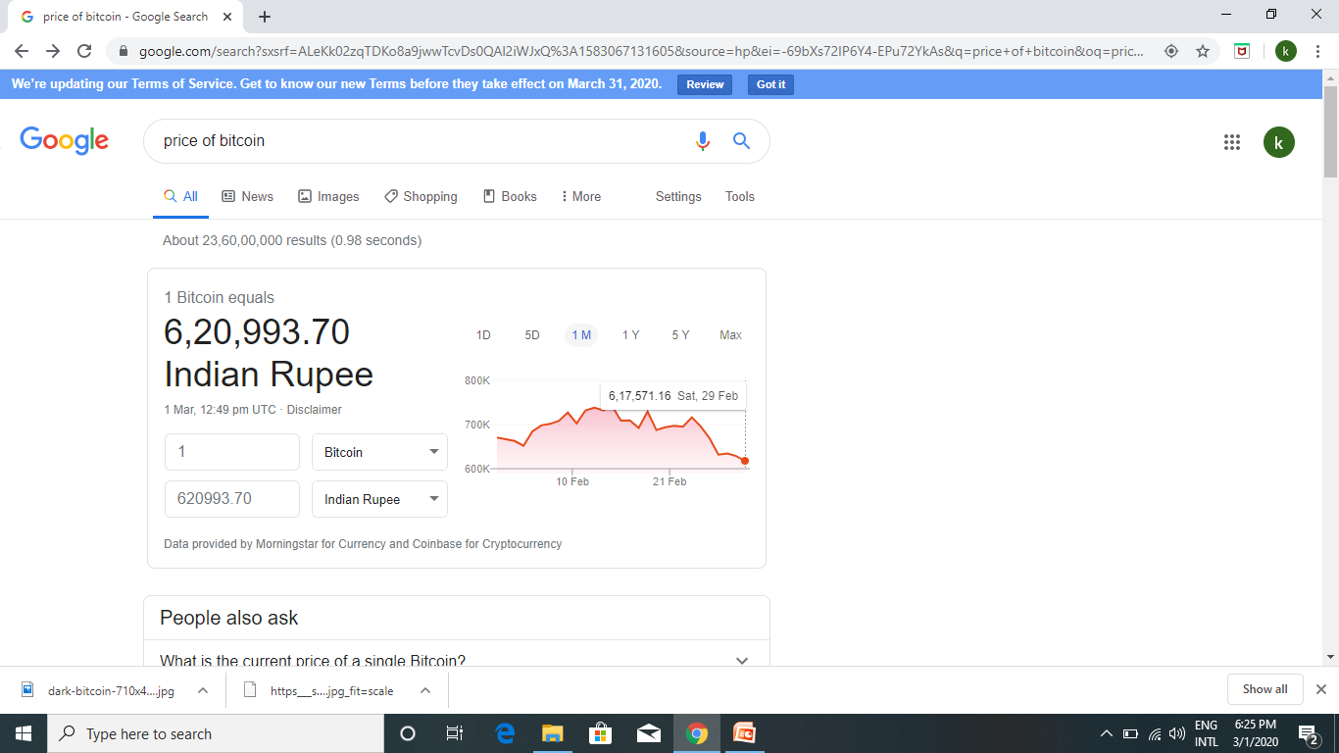
INTRODUCTION
Objectives:
Why predict price change?

Slide 4
INTRODUCTION
Features of Bit coin:
• Tax free
• Unforgeable
• Bordless and unbound from distance
• Decentralized
• Verifiable and secure
• Normally, negligible transaction fees
• Cannot be counterfeited

Slide 5
INTRODUCTION
Why is this topic of area important to study?
>To improve their economical position
>Its qualities as a software and a decentralized system, can not be beaten by banking systems, or a likes.

Slide 6
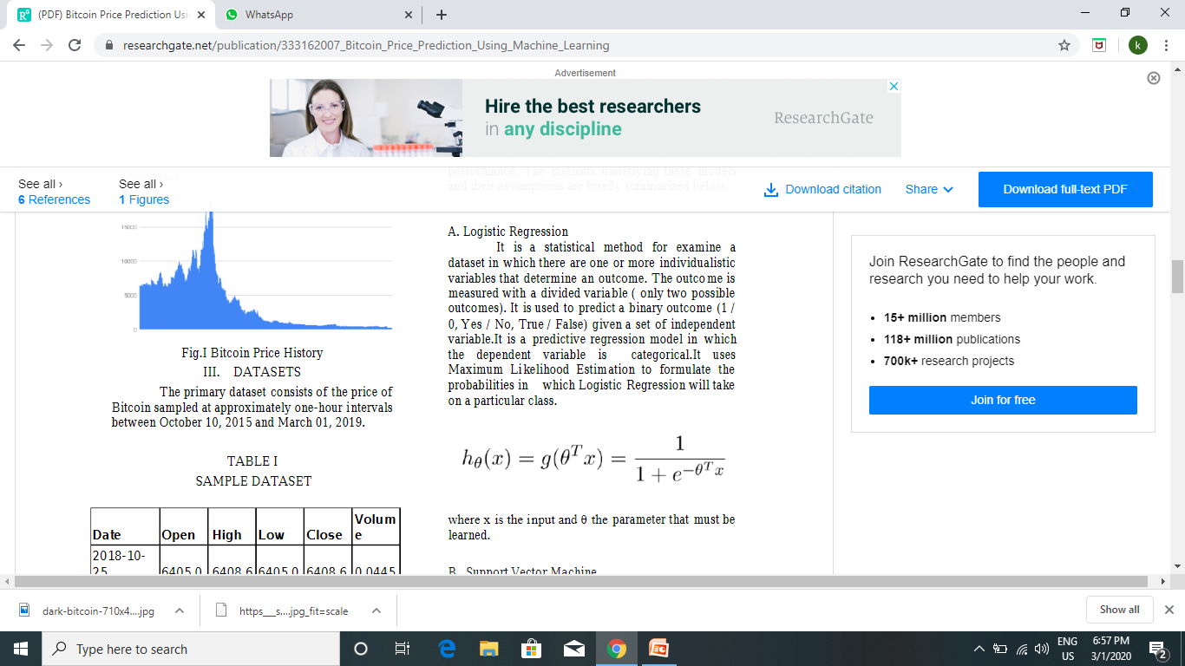
LITERATURE SURVEY
Method 1- Logistic Regression

Slide 7
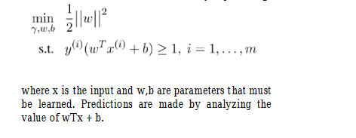
LITERATURE SURVEY
Method 2- Support Vector Machine

Slide 8

LITERATURE SURVEY
Method 3- Auto Regressive Integrated Moving Average (ARIMA)

Slide 9

LITERATURE SURVEY
Method 4- Recurrent Neural Network

Slide 10
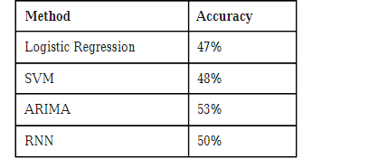
LITERATURE SURVEY
Conclusion

Slide 11
EXISTING SYSTEM
Model built: Research on predicting the price of Bitcoin using machine learning algorithms specifically is lacking. A latent source model built using Bayesian optimization developed to predict the price of Bit coin noting 89% return in 50 days with a Sharp ratio.
Data taken: There has also been work using text data from social media platforms and other sources to predict Bitcoin prices. investigated sentiment analysis using support vector machines coupled with the frequency of Wikipedia views, and the network hash rate. investigated the relationship between Bitcoin price, tweets and views for Bitcoin on Google Trend.

Slide 12
DISADVANTAGES
However, one limitation of such studies is the often small sample size, and propensity for misinformation to spread through various (social) media channels such as Twitter or on message boards such as Reddit, which artificially inflate/deflate prices.
In the Bit coin exchanges liquidity is considerably limited. As a result, the market suffers from a greater risk of manipulation. For this reason, sentiment from social media is not considered further

Slide 13
PROPOSED SYSTEM
Change in model: This approach was taken for parameters which were unsuitable for Bayesian optimization. This model was built using Keras in the Python programming language . Similar to the RNN, Bayesian optimization was chosen for selecting LTSM parameters where possible.
The expected improvement over the best result to pick hyper parameters for the next experiment. The performance of both the RNN and LSTM network are evaluated on validation data with measures to prevent over fitting. Dropout is implemented in both layers, and we automatically stop model training if its validation loss hasn’t improved in 5 epochs.

Slide 14
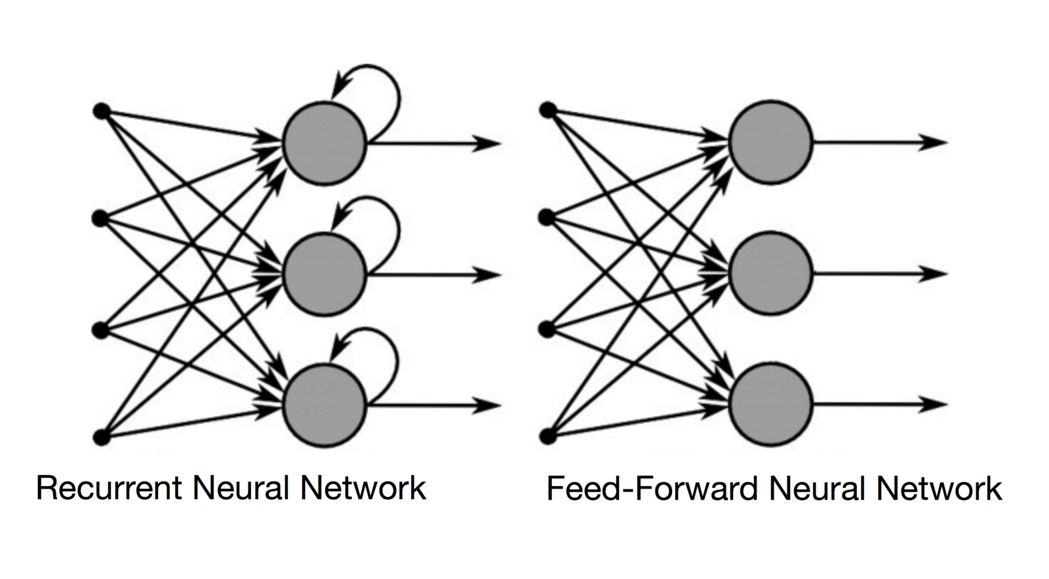
ARCHITECTURE

Slide 15
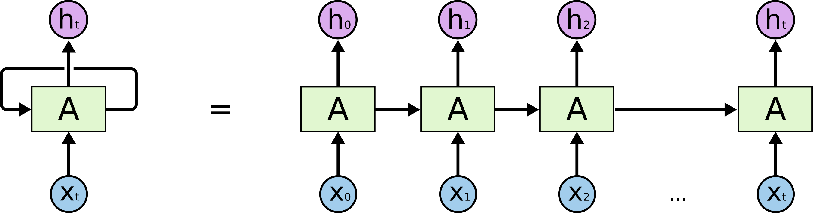
ARCHITECTURE

Slide 16
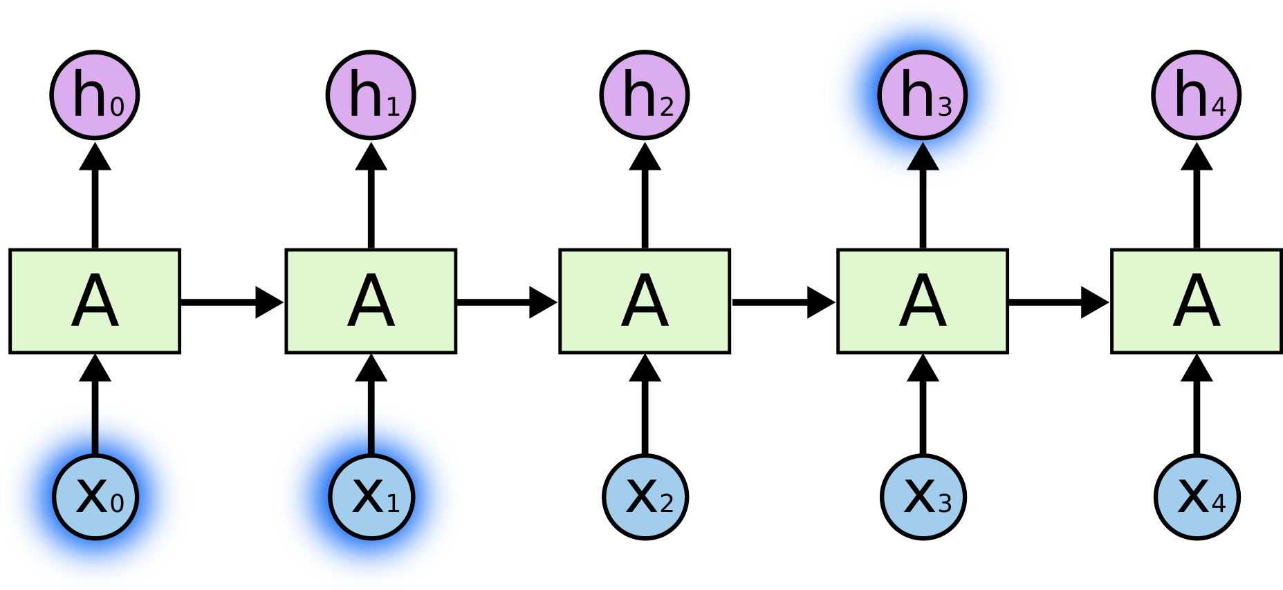
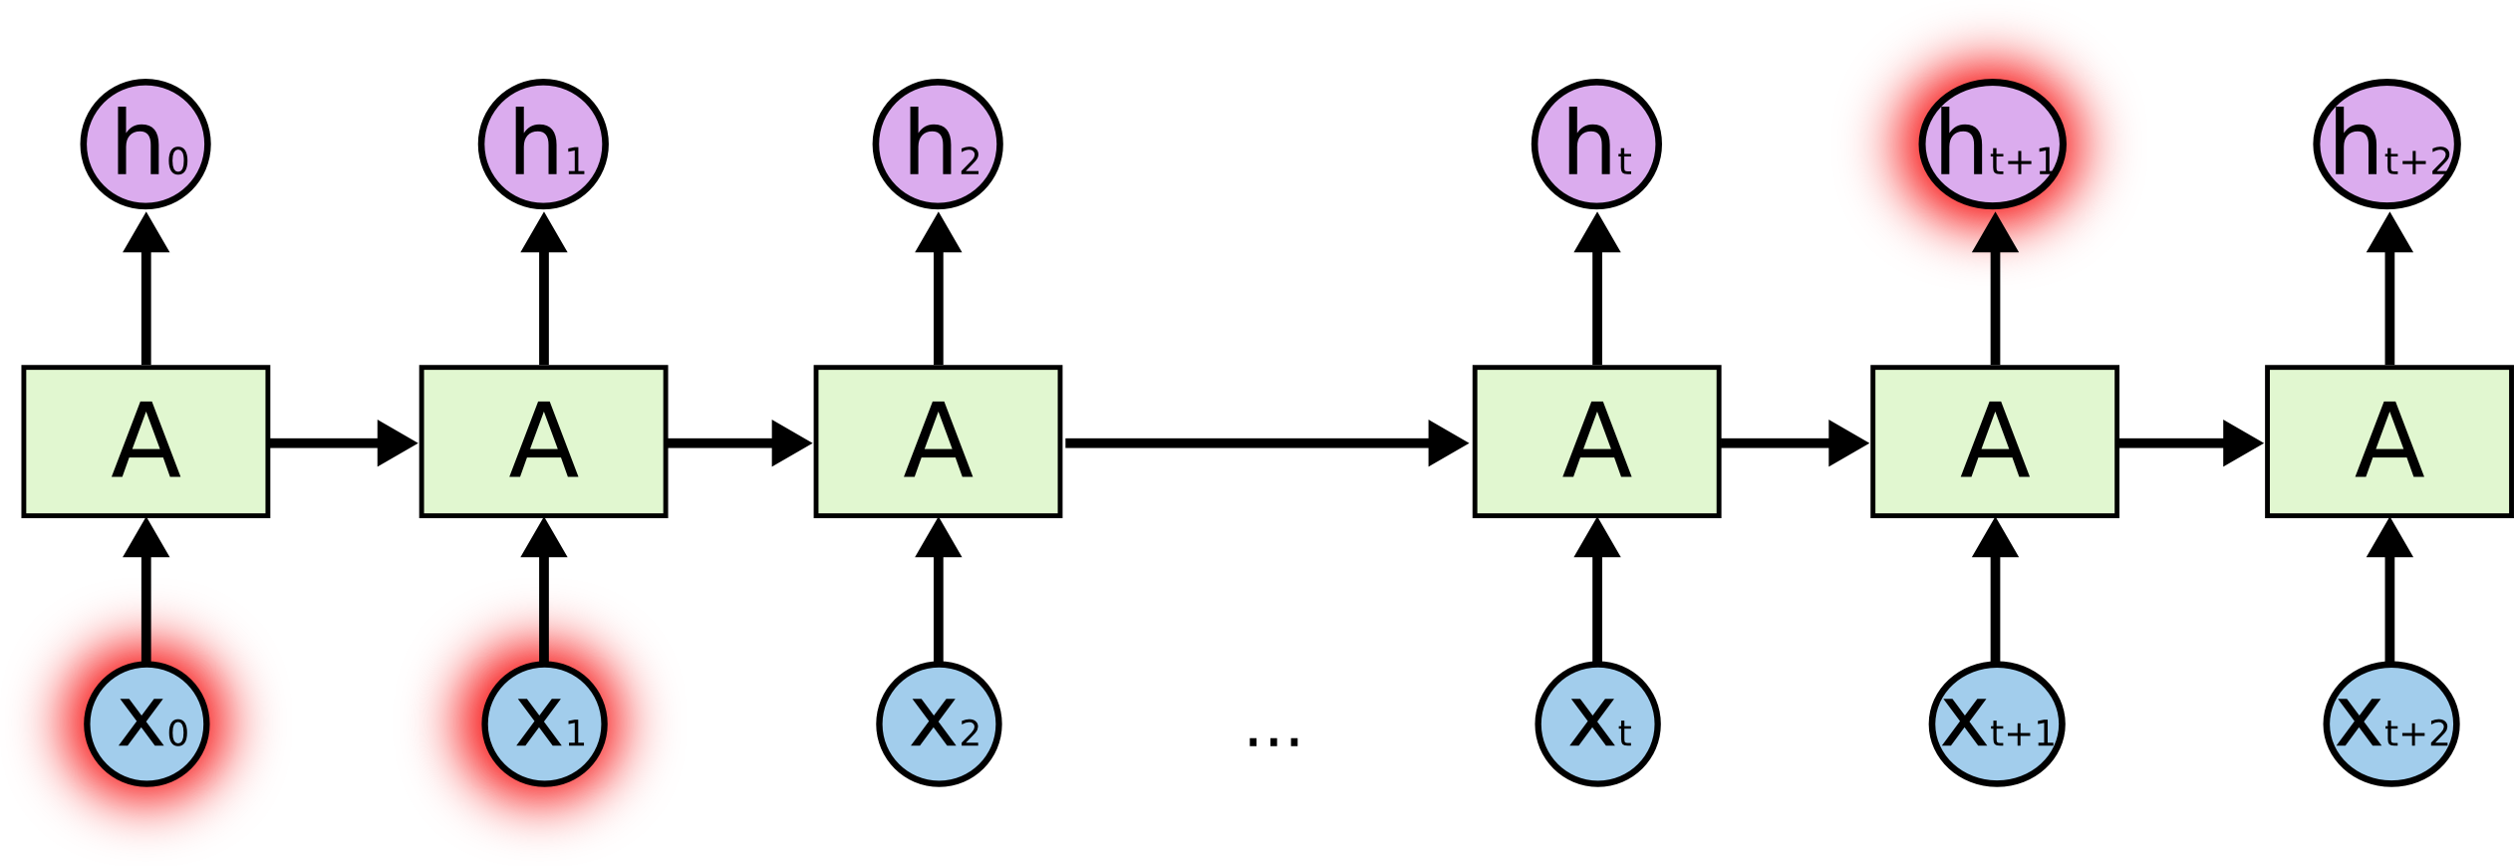
ARCHITECTURE

Slide 17

ARCHITECTURE
LSTM:

Slide 18
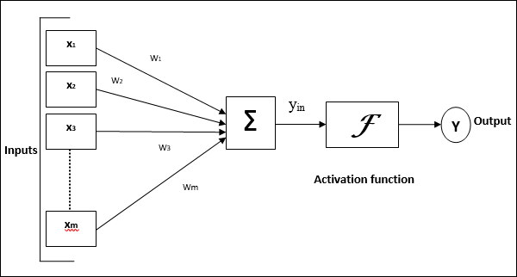
ARCHITECTURE

Slide 19
ALGORITHM
Data set selected: Live data
> import poloniex
{ Concepts used on data: SMA, Boruta (boruta_py), Bayesian optimization (hyperlibrary2) and grid search }
Test and train set
>from sklearn.model_selection import train_test_split
Fitting
>model.fit()
Predict the output
>import matplotlib.pyplot as plt

Slide 20
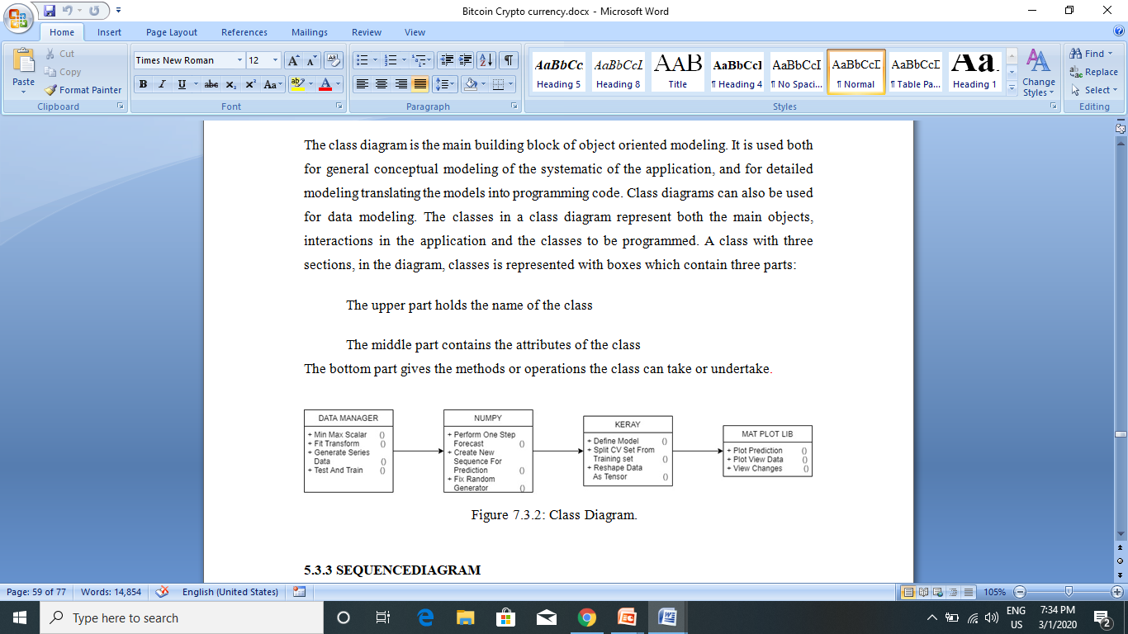
FLOWCHART

Slide 21
ADVANTAGES
Accuracy
Short code
Less time
We automatically stop model training if its validation loss hasn’t improved in 5 epochs.
Prevention of over fitting

Slide 22
SYSTEM REQUIREMENTS
HARDWARE REQUIREMENTS:
System : Pentium Dual Core.
Hard Disk : 120 GB.
Monitor : 15’’ LED
Input Devices : Keyboard, Mouse
Ram : 1GB.

Slide 23
SYSTEM REQUIREMENTS
SOFTWARE REQUIREMENTS:
Operating system : Windows 7.
Coding Language : python
Environment : Anaconda,
Tools : visual studio code
Libraries : Scipy, numpy, sklearn,
seaborn

Slide 24
THANK YOU

